Slide 1

World University Ranking Analysis Using Machine Learning
Presented By: Group 7

Slide 2

Group Members
Snehal Dhatrak
CWID: 20035911
Aman Chouksey
CWID: 20032074
Shreya Sridhar
CWID: 20029395
Shradha Sridhar
CWID: 20029348

Slide 3
Introduction
University rankings have become a pivotal benchmark in shaping strategic decisions across the global academic landscape—from student enrollment and faculty hiring to research investments and institutional partnerships. Yet, traditional ranking systems often rely on limited, and at times subjective, metrics that may not fully reflect the multifaceted nature of academic excellence. These conventional approaches can overlook critical indicators such as interdisciplinary research, international collaboration, and the socio-economic impact of universities.
To overcome these constraints, this project adopts a comprehensive, data-driven methodology that leverages machine learning to evaluate university performance with greater accuracy and depth. By integrating a diverse range of quantitative indicators—including teaching quality, research productivity, citation impact, global outlook, and industry engagement—the study aims to uncover latent patterns and derive a more holistic understanding of institutional success.
Using advanced analytical tools such as clustering algorithms and regression models, this approach enhances the transparency, objectivity, and interpretability of the ranking process. Ultimately, the insights generated empower key stakeholders—including policymakers, educators, and prospective students—to make more informed and strategic decisions in the dynamic realm of higher education.
© Stevens Institute of Technology

Slide 4
Project Objective
The primary objective of this project is to develop a robust, data-driven framework for evaluating and ranking global universities by integrating a broad spectrum of academic and operational metrics. Key performance indicators such as research output, teaching effectiveness, international diversity, citation impact, and industry collaboration are systematically analyzed to capture the multifaceted nature of institutional excellence.
By applying advanced machine learning techniques—including regression analysis and clustering algorithms—this approach aims to move beyond traditional, one-dimensional ranking models. The goal is to deliver a more comprehensive, accurate, and equitable evaluation of universities worldwide. This enriched methodology not only promotes transparency and fairness in the ranking process but also equips stakeholders with deeper, evidence-based insights for strategic planning and decision-making in the global higher education ecosystem.
© Stevens Institute of Technology

Slide 5
Problem Statement
Traditional university ranking systems, while highly influential in shaping global academic decisions—including student enrollment, funding allocation, and institutional prestige—are often constrained by a narrow and sometimes subjective set of evaluation criteria. These rankings typically emphasize metrics such as faculty-to-student ratios or academic reputation, which may not comprehensively reflect the dynamic and multifaceted nature of institutional performance. As a result, crucial factors such as research impact, international diversity, industry collaboration, and innovation potential are frequently underrepresented or overlooked.
This limited perspective can lead to skewed evaluations, misinformed decision-making, and an incomplete understanding of a university's true capabilities. To address these shortcomings, this project proposes a holistic, data-driven alternative that integrates a wide array of academic and operational indicators—including research output, teaching quality, citation influence, and industry revenue—into a unified analytical framework. By applying machine learning techniques such as regression and clustering, the project seeks to uncover deeper patterns, correlations, and performance drivers within the data. The ultimate aim is to deliver a more accurate, transparent, and insightful understanding of the factors that shape university success on a global scale.
© Stevens Institute of Technology

Slide 6
Dataset Overview
The dataset, sourced from Kaggle, includes multi-year data on top global universities and captures a wide range of academic and operational metrics.
Key features include:
University name, country, and year
Teaching score (based on surveys and faculty credentials)
Research score (output, funding, reputation)
International outlook (ratio of international staff and students)
Citations score (research influence)
Industry income (funding from industry)
Total score and world rank
This comprehensive dataset serves as the foundation for applying machine learning techniques to evaluate institutional performance more holistically.
© Stevens Institute of Technology

Slide 7
Data Loading and File Handling
The data is stored in CSV format and includes multiple files from the input directory. The primary file, timesData.csv, is loaded and combined with others if necessary for consistency across years. During the data loading phase, attention is paid to ensure encoding consistency and that all fields are appropriately interpreted by the analysis tools. The dataset is inspected for shape, structure, and completeness, and all files are processed using efficient file handling techniques to ensure seamless data integration. This step lays the groundwork for subsequent preprocessing and analysis.
© Stevens Institute of Technology

Slide 8
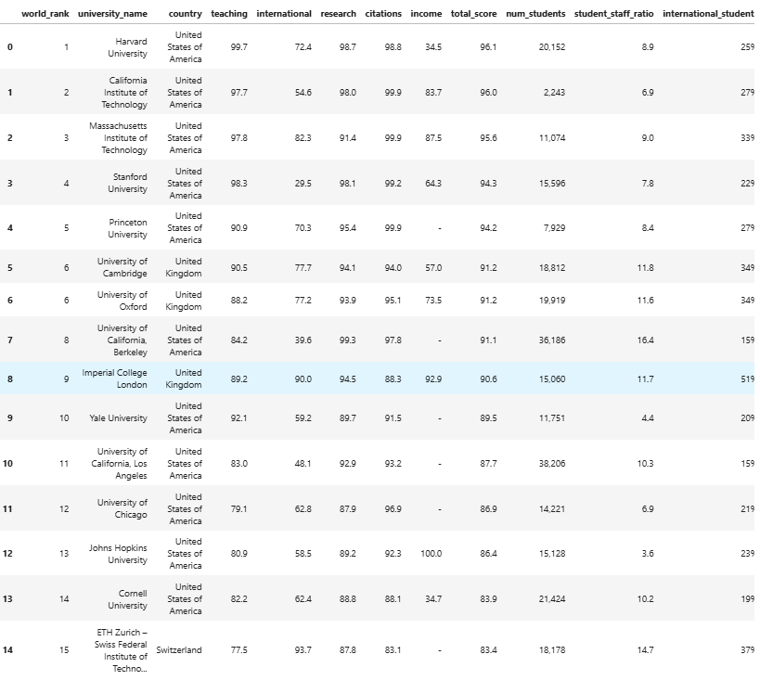
Data Loading and File Handling
© Stevens Institute of Technology

Slide 9
Cleaning data
To ensure consistency and accuracy in the analysis, several preprocessing steps were applied to clean and standardize the dataset. Correcting country names safely involved mapping inconsistent or misspelled entries to standardized country names to maintain uniformity across records. In correcting the ranking system, placeholder entries such as "=" signs were removed, and ranking values were safely converted to integers. The international students column, which originally contained percentage signs, was cleaned by stripping the "%" symbol and converting the resulting string to a float for numerical analysis. Similarly, female-to-male ratio values were formatted by replacing ":" with "/", evaluating the expression, and converting it to a float to reflect the proportion numerically. A function to remove native characters was implemented to strip out any non-ASCII symbols from university names or text fields, ensuring clean string data. Lastly, other value fixes and type conversions were made, including handling missing or malformed entries and converting relevant columns to appropriate data types, such as float or integer, to support machine learning model training and analysis.
© Stevens Institute of Technology

Slide 10
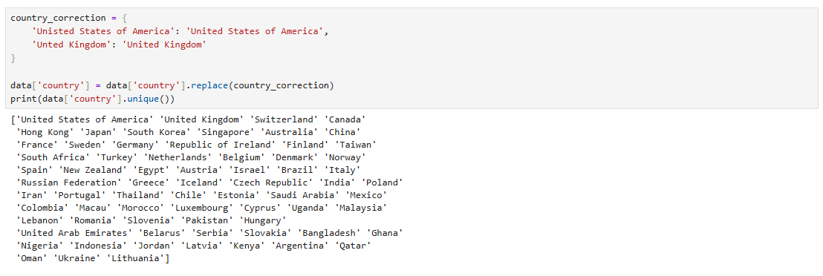
Correcting country names safely
© Stevens Institute of Technology

Slide 11
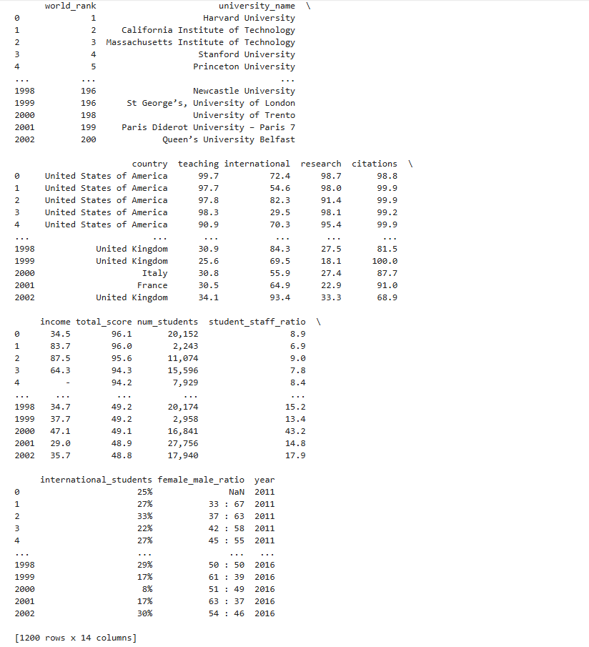
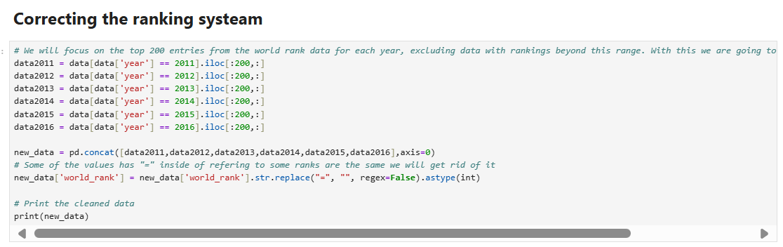
Correcting the ranking system
© Stevens Institute of Technology

Slide 12
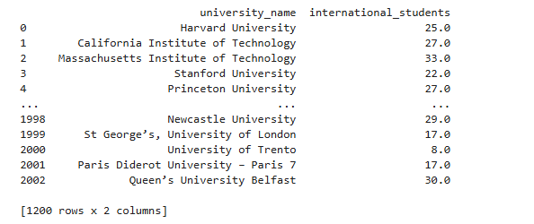
Fixing the international students values and removing "%" then changing value to a float
© Stevens Institute of Technology

Slide 13
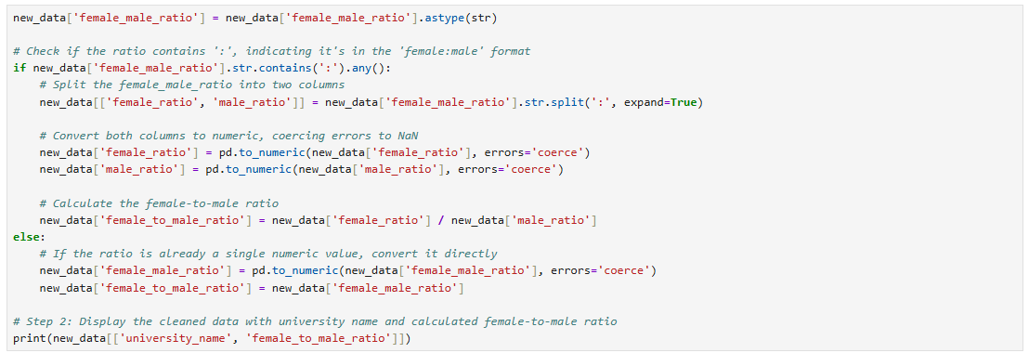
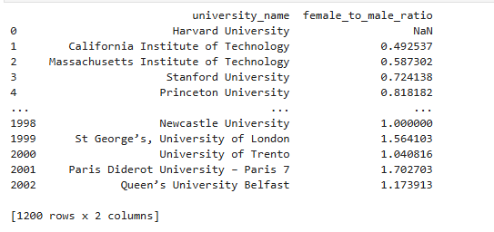
Fixing female to male ratio values and changing the type
© Stevens Institute of Technology

Slide 14
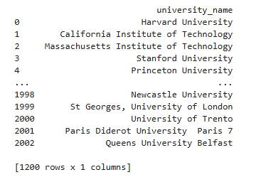
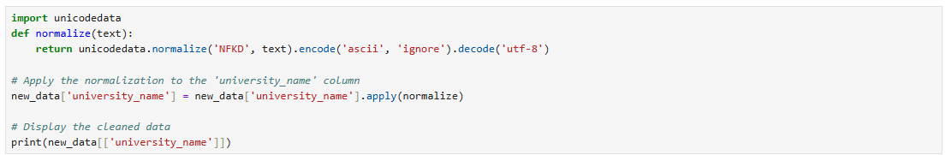
Function to remove native characters
© Stevens Institute of Technology

Slide 15
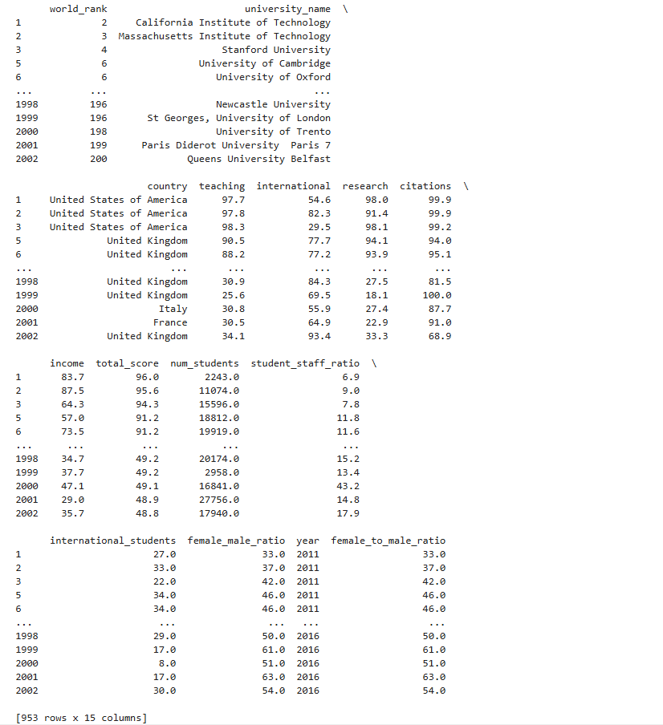
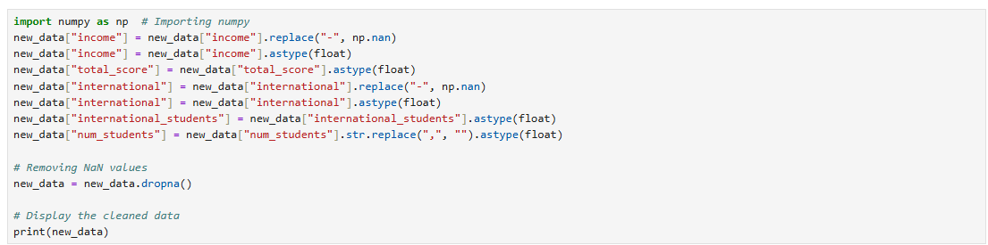
Fixing other values and changing the type
© Stevens Institute of Technology

Slide 16
Classification Algorithms
K- Means Clustering
Linear Regression
Random Forest Regressor

Slide 17
K-Means Clustering
To identify natural groupings of universities based on performance metrics, K-Means clustering is implemented. This unsupervised learning method groups institutions into clusters with similar profiles in terms of teaching, research, and citation scores. The clustering reveals valuable insights into performance tiers, highlighting distinctions between high-performing global institutions, developing universities, and those with specialized strengths. These clusters serve as qualitative segments that can be used for benchmarking and comparative analysis. It becomes apparent that institutions within the same cluster often share geographic, financial, or structural similarities.
© Stevens Institute of Technology

Slide 18
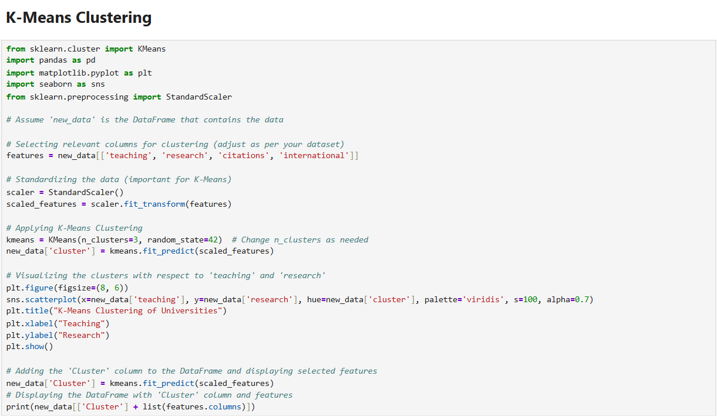
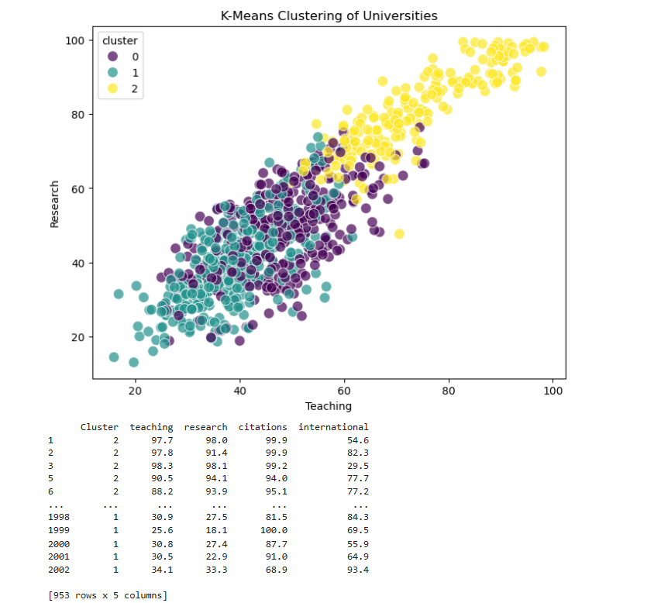
K-Means Clustering
© Stevens Institute of Technology

Slide 19
Linear Regression
Linear regression is used to model the relationship between university rank and several independent variables, including teaching, research, citations, and income. The goal is to determine how well these variables can predict a university’s global ranking. The linear regression model assumes a direct, proportional relationship between the input features and the target variable (world rank). The findings suggest that while the model is useful in identifying general trends, the linearity assumption may not fully capture the complexity of interactions between institutional features. Nonetheless, the model provides a baseline understanding of which features most strongly influence rank, with citations and research emerging as consistently significant predictors.
© Stevens Institute of Technology

Slide 20
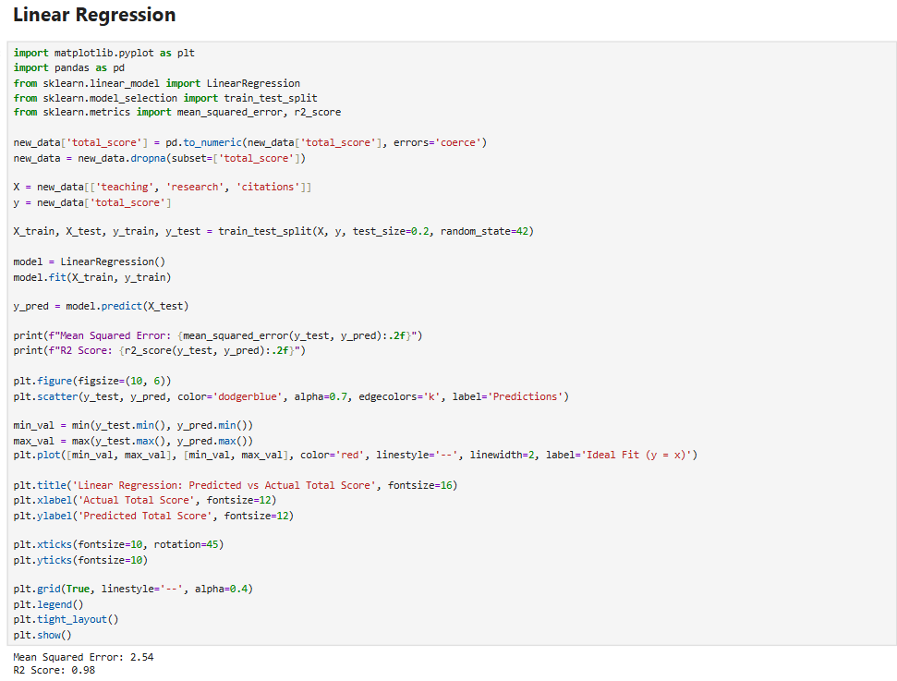
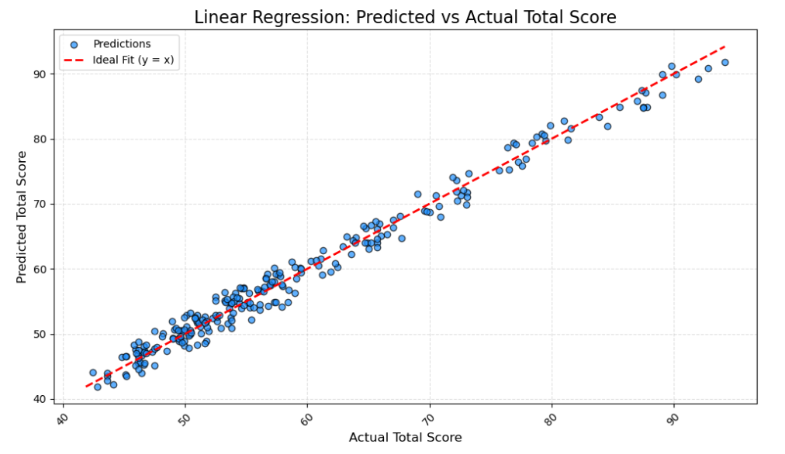
Linear Regression
© Stevens Institute of Technology

Slide 21
Random Forest Regressor
To overcome the limitations of linear models, a Random Forest Regressor is introduced. This ensemble learning method constructs multiple decision trees and merges their outputs to provide more accurate and stable predictions. Unlike linear regression, it can capture non-linear relationships and interactions among features. The Random Forest model offers significant advantages, including robustness to outliers and the ability to evaluate feature importance. Analysis reveals that citation impact and research output are the most influential variables in predicting university rank. The model’s superior accuracy validates the hypothesis that university rankings are shaped by complex, non-linear interactions among multiple institutional attributes.
© Stevens Institute of Technology

Slide 22
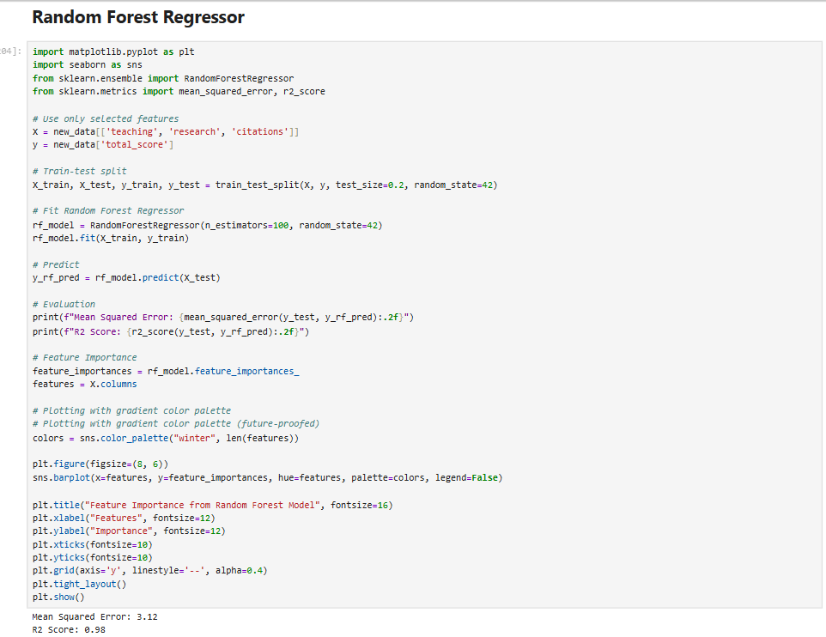
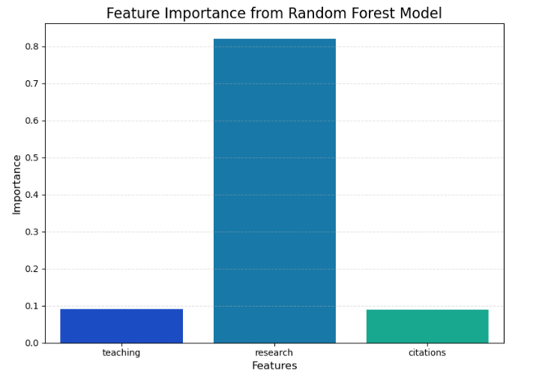
Random Forest Regressor
© Stevens Institute of Technology

Slide 23
Visualization Technique
Pair Plot
Heatmap
Scatter Plot
Bar Plot

Slide 24
Pair Plot
Pair plots are utilized to visualize the pairwise relationships between several numerical variables in the dataset. This technique provides a comprehensive view of how features such as teaching, research, and citations relate to one another and to the target variable (world rank). The plots reveal that features often thought to be independent—like teaching and research—are in fact positively correlated. These visualizations also help in identifying outliers and patterns that may not be immediately evident through numerical summaries alone. For example, it becomes clear that institutions with high research and citation scores tend to cluster together and are generally ranked higher.
© Stevens Institute of Technology

Slide 25

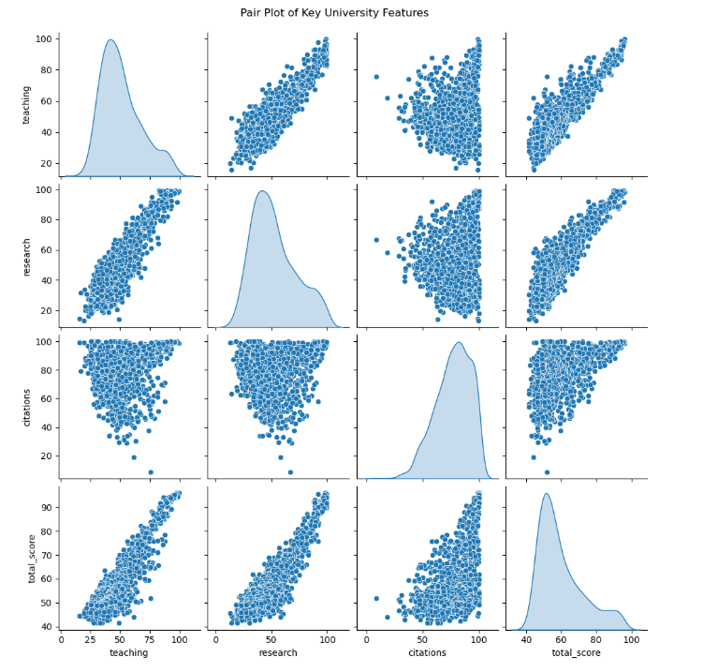
Pair Plot
© Stevens Institute of Technology

Slide 26
Heatmap
A heatmap of the correlation matrix offers a visual summary of relationships among all numerical features in the dataset. The heatmap highlights strong positive correlations between teaching, research, and citations, suggesting that excellence in one domain often accompanies excellence in others. Negative correlations with world rank (where lower rank indicates better performance) confirm that higher research and citation scores correspond to better institutional rankings. This visualization is instrumental in guiding feature selection and supports the findings from both regression and clustering analyses.
© Stevens Institute of Technology

Slide 27
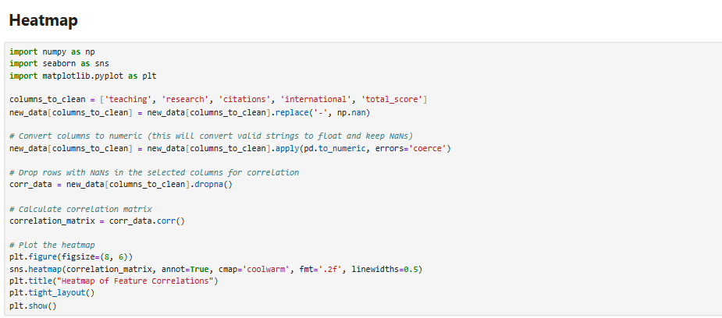
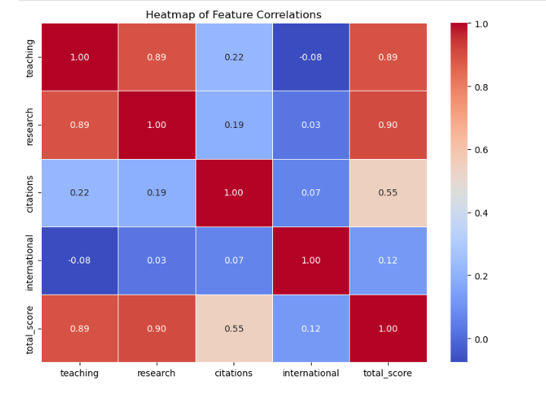
Heatmap
© Stevens Institute of Technology

Slide 28
Scatter Plot
Scatter plots are used to examine specific relationships between key features and university rankings. For example, plotting citations against world rank reveals a clear inverse relationship—universities with higher citation scores tend to have lower (better) ranks. Such plots make it easier to communicate the direction and strength of relationships between variables. They also highlight the presence of clusters or anomalies, such as institutions that perform exceptionally well in citations despite lower scores in other categories.
© Stevens Institute of Technology

Slide 29
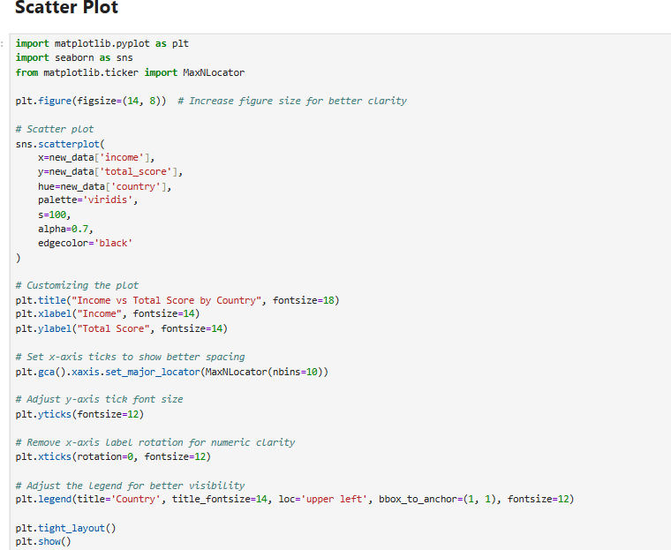
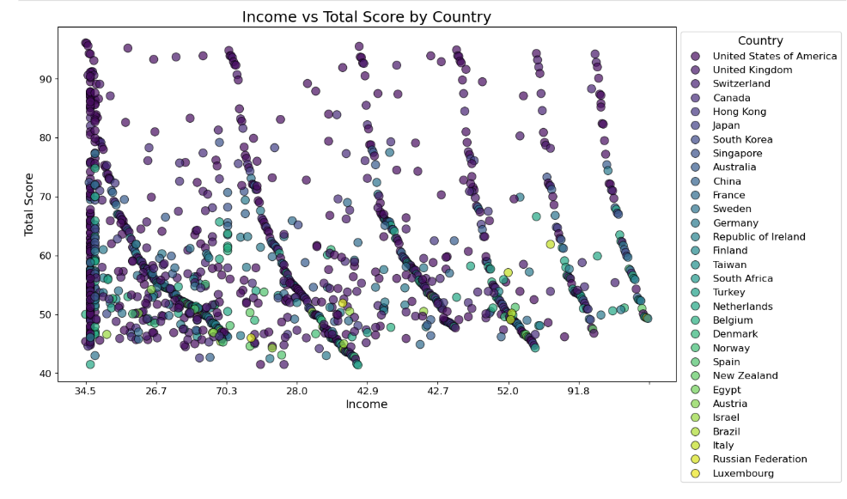
Scatter Plot
© Stevens Institute of Technology

Slide 30
Bar Plot
Bar plots are employed to showcase the distribution of top-ranked universities by country. This analysis brings a geographic perspective to the data, highlighting which nations dominate the global education landscape. Countries like the United States and the United Kingdom frequently appear among the top performers, suggesting a combination of historical prestige, funding, and research infrastructure. The bar plots provide context to the numerical rankings and help visualize broader geopolitical patterns in higher education excellence.
© Stevens Institute of Technology

Slide 31
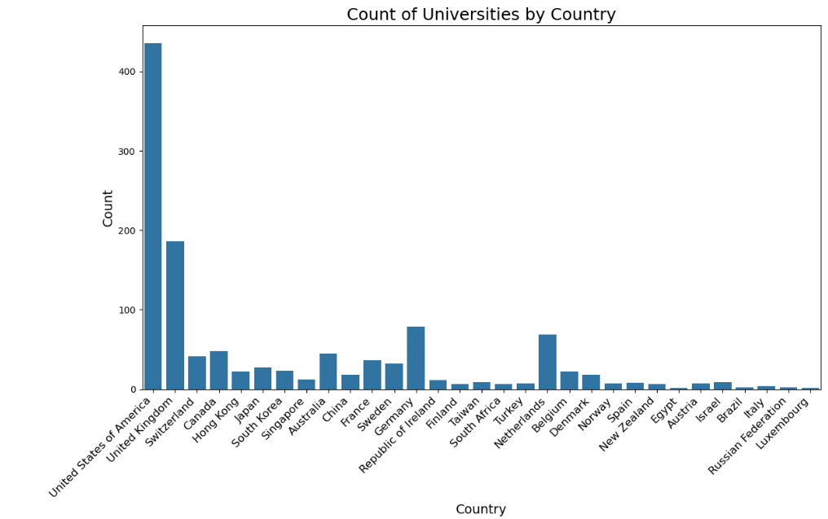
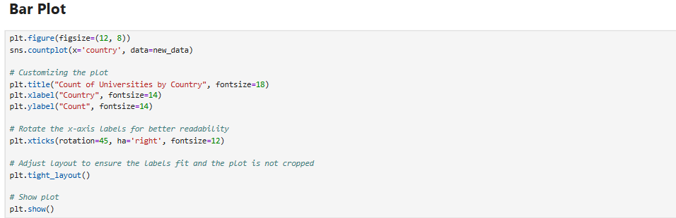
Bar Plot
© Stevens Institute of Technology

Slide 32
Conclusion
This research demonstrates the transformative potential of applying machine learning techniques to academic datasets in redefining how university performance is evaluated. By leveraging both supervised learning methods—such as Linear Regression and Random Forest Regressor—and unsupervised techniques like K-Means Clustering, the study effectively uncovers the key drivers behind global university rankings. The analysis not only reaffirms the critical role of teaching quality, research output, and citation impact but also draws attention to often underemphasized factors like industry income and international diversity, revealing areas where institutions can enhance their global standing.
Beyond ranking alone, this project lays the groundwork for a more equitable and insightful evaluation framework—one that reflects real-world academic dynamics rather than relying solely on traditional, narrow metrics. It empowers a diverse group of stakeholders—including students, educators, institutions, and policymakers—with data-backed insights for strategic planning, resource allocation, and academic improvement. Ultimately, the integration of machine learning offers a powerful path forward for building more transparent, inclusive, and informed university ranking systems on a global scale.
© Stevens Institute of Technology

Slide 33
Thank You!

